Slide 1
On-Page and Off Page Optimization

Slide 2
On –Page Optimization - Keyword Planning
Your SEO keywords are the key words and phrases in your web content that make it possible for people to find your site via search engines.
you need to know how people are looking for the products, services or information that you offer, in order to make it easy for them to find you—otherwise, they'll land on one of the many other pages in the Google results.
Implementing keyword SEO will help your site rank above your competitors.

Slide 3
On –Page Optimization - Keyword Planning
1) Getting started with a brainstorm list
2) Selecting and Using a Keyword Research Tool
3) Refining your list using suggested keyword phrases from an analysis tool
4) Verifying keyword phrase relevance
5) Looking at search volume to determine consumer demand
6) Analyzing the competitive space to make sure you and the searcher think the keywords mean the same things, and to decide if the space is too competitive

Slide 4
On-Page Ranking Factors
Many on-page ranking factors are related to the use of keywords while some other factors are not directly related to keywords.

Slide 5
On-Page Ranking Factors
Keywords in the <title> Tag
Keywords in the Page URL
Keywords in the Page Copy
Keywords in the <meta> Description Tag
Keywords in the Heading Tags
Keyword Proximity
Keyword Prominence
Keywords in the Link Anchor Text
Quality Outbound Links
Web Page Age
Web Page Size

Slide 6
Keywords in the <title> Tag
According the recommendation of World Wide Web Consortium (W3C) about HTML titles:
Authors should use the TITLE element to identify the contents of a document.
Since users often consult documents out of context, authors should provide context-rich titles.
Thus, instead of a title such as “Introduction”, which doesn’t provide much contextual background, authors should supply a title such as “Introduction to Medieval BeeKeeping” instead.

Slide 7
Eearch engines like Google show meta tags in their search results. You perform a search task by filling out:
(A) certain keywords. The results you will get is
(B) the title tag and
(C) the small text item, the description tag.

Slide 8
Meta Tag: Description
Description is meta tag that you add at the top of the web page, inside the <head>tag.
The Description meta tag provides a brief summary of the webpage and its content.
Search crawlers use this tag to get information about the page content and display it in the search results.
Unlike with the Title tag, you can use a greater number of characters to describe your website.
Make sure to use optimized keywords that represent the website content.

Slide 9
Meta Tag: Description
Here is the format of a <meta> description tag:
<meta name="description" content="Optimized Description with Important Keywords. This text can be a short paragraph. Use important page copy keywords in this description.“>
Ex:
<meta name="description" content="O'Reilly Media spreads the knowledge of technology innovators through its books, online services, magazines, and conferences. Since 1978, O'Reilly has been a chronicler and catalyst of leading-edge development, homing in on the technology trends that really matter and spurring their adoption by amplifying'faint signals' from the alpha geeks who are creating the future." />

Slide 10
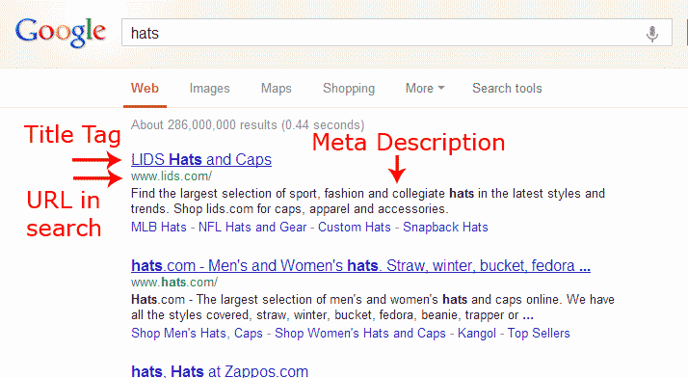
Meta Tag: Description

Slide 11
Meta Tag: Keyword
The Keyword meta tag includes individual keywords separated by commas.
Search engine crawlers use the Keyword meta tag information to index the website and display it in the search results.
The keywords should be descriptive and optimized to ensure that the search engine displays the website when users search for these specific keywords.
<meta name="keywords" content="Keyword1, Keyword2, Keyword3">

Slide 12
Meta Tag: Keyword
It's very important that you add the keywords you want your site to be found under in your KEYWORD tag.
If a search engine spider finds the same words on your website and in your meta tags, these words will be ranked higher in the search index.
Don't add too many words, the most search engines will only index the first 20 words. Make sure that you put the 10 most important keywords first.

Slide 13
Meta Tag: Keyword
Limit your number of keywords to around 2 to 5 percent of your content. Overloading your web page with keywords is considered stuffing, and it may negatively affect your Google rank.
Some search engines overlook the Keyword tag, but it is still useful in others.

Slide 14
Meta Tag: Author
The Author meta tag includes information about the web page’s creator, or webmaster, as well as contact information, an e-mail, and the company name.
Some people use separate tag ‘contact’ to give contact details.
It is not important as description, tile or keyword tag.

Slide 15
Meta Tag: Author
<meta name="author" content="text">
Ex:<meta name="author" content="John Smith">
Contact tag
<meta name="contact“ content="email@address">
Copyright tag <meta name="copyright" content="name of owner">

Slide 16
Country
<META NAME="geo.position" CONTENT="latitude; longitude"> <META NAME="geo.placename" CONTENT="Place Name"> <META NAME="geo.region" CONTENT="Country Subdivision Code">
<META NAME="geo.position" CONTENT="49.2;-123.4"> <META NAME="geo.placename" CONTENT="London"> <META NAME="geo.region" CONTENT="CA-ON">

Slide 17
Country
Geo tags are generally used if your website/business is location specific.
A restaurant would be a good example of this as it has a physical location relevant to the services it is offering.
The tag Placed on each page of the website, these let the search engines know where you’re based and could help improve your search engine rankings for local related search terms.

Slide 18
Meta tag: robots
It explain to a spider of a search engine you only want it to index just the first page of your website or that it is allowed to index the whole website.
You use a specific HTML meta tag the so called the meta robots tag.
<meta name="robots" content="selection">

Slide 19
Meta tag: robots
<meta name="robots" content="index, follow">
The spider will now index your whole website.
The spider will not only index the first web-page of your website but also follow outbound links

Slide 20
Meta tag: robots
<meta name="robots" content="index, nofollow">
The spider will now only look at this page and stops there.
<meta name="robots" content="noindex, follow"> The spider will not look at this page but will crawl through the rest of the pages on your website.
<meta name="robots" content="noindex, nofollow">
The spider will not look at this page and will NOT crawl through the rest of your web-pages.

Slide 21
Meta tag: robots
<!-- Tells Yahoo! to not use Yahoo! Directory description -->
<meta name="robots" content="noydir" />
<!-- Tells search engines to not use ODP (Open Directory Project.) description -->
<meta name="robots" content="noodp" />
<!-- Tells search engines to not use either of the two directories -->
<meta name="robots" content="noodp,noydir" />

Slide 22
Meta tag: robots
<meta name="googlebot" content="noodp">
<!-- Note: Only Yahoo! uses Yahoo! Directory -->
<meta name="slurp" CONTENT="noydir">
<meta name="msnbot" CONTENT="noodp">

Slide 23
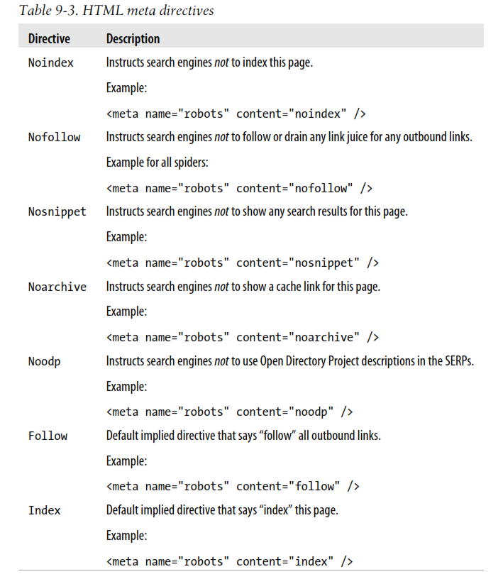
Meta tag: robots

Slide 24
Meta tag for redirection (HTTP-EQUIV "REFRESH")
By using HTTP-EQUIV "REFRESH" tag you are able to define after how long a page has to be refreshed or after a certain period of seconds you want your visitor to be redirected to another webpage.
Search engines usually don't like it when you use refresh pages. A better solution is to add a click-able link.
It can influence your ranking in a negative way by using this tag the wrong way!

Slide 25
Meta tag for redirection (HTTP-EQUIV "REFRESH")
<meta http-equiv="refresh" content="value">
Ex
www.yourevent.com/2011registration.html
www.yourevent.com/2012registration.html
Whenever page number 1 isn't active anymore you replace it with a new page adding the text 2011 closed, but register yourself now for 2012. Now you add a refresh tag so your visitor will be redirected immediately to the next page. <meta http-equiv="refresh" content="10; ,URL=/2012registration.html"> "10" is the number of seconds it takes to go from the redirection page to the new page. NOTE: many people don't like these browser influences. They want to decide themselves on which button they click and find the 'redirection' annoying. So be careful using these influence methods. Sometimes adding a click-able link is a better solution.

Slide 26
Meta tag for redirection (HTTP-EQUIV "REFRESH")
Told the page to refresh after 30 sec
<meta http-equiv="refresh" content="30">

Slide 27
Heading Tag
The H(x) tags in HTML (H1, H2, H3, etc.) are designed to indicate a headline hierarchy in a document.
Thus, an H1 tag might be considered the headline of the page as a whole, whereas H2 tags would serve as subheadings, H3s as tertiary-level headlines, and so forth.

Slide 28
Heading Tag
Search engines recognize the copy in your header tags as more important than the rest.
This starts with your h1 and works its way down in importance to the h2, h3 and so on.
The h1 tag should contain your targeted keywords, ones that closely relate to the page title and are relevant to your content.
The h2 tag is a subheading and should contain similar keywords to your h1 tag.
Your h3 is then a subheading for your h2 and so on.
Think of them as a hierarchy based on importance, the above being more important than the below.

Slide 29
Heading Tag
Keep in mind that it’s also very import that your header tags are readable and grammatically correct.
Stuffing your h1, h2 and h3 with keywords is not going to help your cause.
If anything, Google will recognize this and assume you are trying to manipulate them.

Slide 30
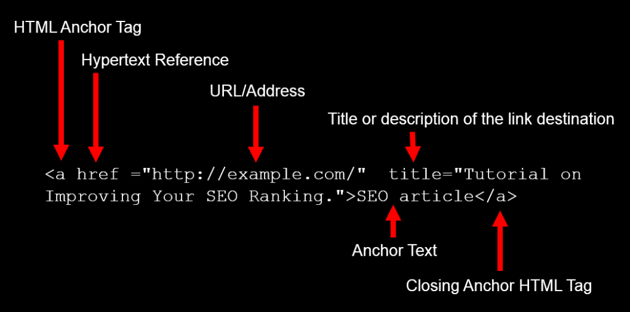
Anchor Text
Anchor text is the visible characters and words that hyperlinks display when linking to another document or location on the web.

Slide 31
Anchor Text
Search engines use external anchor text (text other pages use to link to your site) as a reflection of how other people view your page - and by extension, what your pages may be about. While website owners typically can't control how other sites link to theirs, “you can make sure that anchor text you use within your own site is useful, descriptive, and relevant.”

Slide 32
Anchor Text
Types of anchor text
Exact-match
Anchor text is "exact match" if it includes a keyword that mirrors the page that is being linked to. For example: 'link building' linking to a page about link building.
Partial-match
Anchor text that includes a variation of the keyword on the linked-to page. For example: 'link building strategies' linking to a page about link building.
Branded
A brand name used as anchor text. For example: 'Moz' linking to an article on the Moz Blog.
Naked link
A URL that is used as an anchor 'www.moz.com' is a naked link anchor.

Slide 33
Anchor Text
Types of anchor text
Generic
A generic word or phrase that is used as the anchor. "Click here" is a common generic anchor.
Images
Whenever an image is linked, Google will use the text contained in the image's alt attribute as the anchor text.
SEO-friendly anchor text is:
Succinct
Relevant to the linked-to page
Low keyword density (not overly keyword-heavy)
Not generic

Slide 34
Link Title
link TITLE is supposed to provide additional / advisory information about the link(expand on the meaning of the link).
The anchor text is supposed to “name” the link, while the title text provides information about where the link will send the user. (especially with “click here” and “more” anchor text).
<a href=”/ann-smarty/” title=”Author’s biography”>Ann Smarty</a>
OR
<a href=”/ann-smarty/” title=”More posts by Ann Smarty”>Ann Smarty</a>

Slide 35
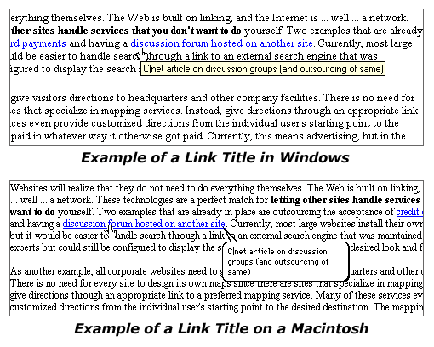
Link Title

Slide 36
Link Title
title attribute carries no weight on search engines (per my experience and based on other SEO’s opinion).
Link TITLE attribute for usability: in most browsers it will pop up when you hover over the link.

Slide 37
Link Title
use it for your users, not search engines (this approach always pays back);
don’t duplicate it with link text (this hurts usability: for example some blind users will hear the same text twice);
don’t put too much weight on the title attributes as not all screen readers may render it (make sure either surrounding text or anchor text explains the link at least the first time you use it).

Slide 38
Robot.txt
Using robots.txt is the original way to tell crawlers what not to crawl.
This method is particularly helpful when you do not want search engines to crawl certain portions or all portions of your website.
The robots.txt file is composed of a set of directives preceded by specific user-agent heading lines signifying the start of directives for a particular crawler.

Slide 39
Robot.txt
The following is an example robots.txt file that instructs three different crawlers:
1 User-agent: *
2 Disallow: /
3 Allow: /blog/
4 Allow: /news/
5 Allow: /private
6
7 User-agent: msnbot
8 Disallow:
9
10 User-agent: googlebot
11 Disallow: /cgi-bin/

Slide 40
Robot.txt
If Yahoo!’s Slurp paid a visit to this site, it would honor the first five lines of robots.txt— as it does not have its own custom entry within this robots.txt file.
This example has several interesting scenarios. For instance, what would Slurp do if it had the following URLs to process?
• http://mydomain.com/blog
• http://mydomain.com/blog/
Which URL would it crawl? The answer would be the second URL, as it fully matches the Allow directive on line 3 of the preceding code. The trailing slash signifies a directory,
whereas the absence of the trailing slash signifies a file.

Slide 41
Robots.txt Directives
The Allow directive
The Allow directive tells web crawlers that the specified resources can be crawled.
When multiple directives are applicable to the same URL, the longest expression takes precedence.
Suppose we had a robots.txt file as follows:
1 User-agent: *
2 Disallow: /private/
3 Allow: /private/abc/

Slide 42
Robots.txt Directives
The Disallow directive
The Disallow directive was the original directive created.
It signified the webmaster’s desire to prohibit web crawler(s) from crawling specified directories or files.
Its basic format is:
Disallow: /directory/
Disallow: /file.ext
Consider the following code fragment:
User-agent: *
Disallow:
In this case, all documents would be allowed for crawling.

Slide 43
Robots.txt Directives
The Disallow directive
Another example:
User-agent: *
Disallow: /
In this case, everything would be disallowed for crawling.
The forward slash (Disallow) argument signifies the web root of your site.

Slide 44
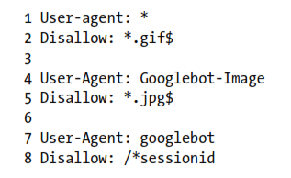
The wildcard directives
Two wildcards are used in robots.txt: $ and *.
Use the dollar sign wildcard ($) when you need to match everything from the end of the URL.
Use the star wildcard character (*) to match zero or more characters in a sequence.

Slide 45

The Sitemap location directive
The Sitemap location directive simply tells the crawler where your Sitemap can be found.
Here is an example of the robots.txt file utilizing the Sitemap directive:

Slide 46
The Sitemap location directive
The Sitemap location directive simply tells the crawler where your Sitemap can be found.
Here is an example of the robots.txt file utilizing the Sitemap directive:
The location of the Sitemap directive is not mandated. It can be anywhere within the robots.txt file.

Slide 47
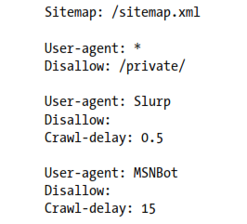
The Crawl-delay directive

Slide 48
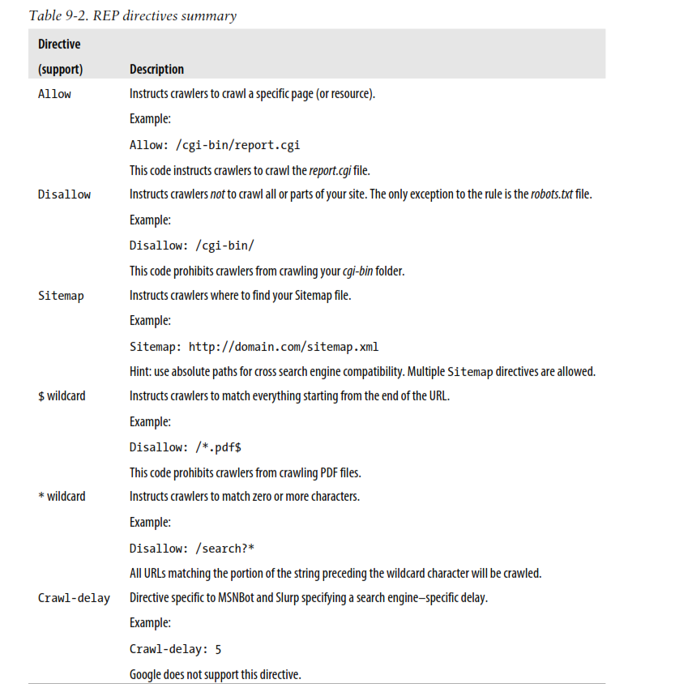

Slide 49
External Ranking Factors- External Links
External links are also known as backlinks, inbound links, and referral links.
Backlinks (or back-links (UK)) are incoming links to a website or web page.
In the search engine optimization (SEO) world, the number of backlinks is one indication of the popularity or importance of that website or page

Slide 50
Know Your Referrers
Google’s link: command: (link:yourdomain.com)
Webmaster Tools
Quantity and Quality of External Links
Speed of backlink accumulation
How fast are you accumulating backlinks?
backlinks using the same anchor text are suspecious

Slide 51
Topical link relevance
the referring sites should also be talking about the same subject matter.
Backlinks from expert sites
Backlinks from .edu and .gov domains
Backlinks from directories
Age of backlinks: old is better
Relative page position: closer to the top of an HTML page is better as compare to down the
Spilling PageRank effect :The greater the number of other links found on the same page, the less of a benefit you will incur.
Relative popularity among peer sites

Slide 52
Broken Outbound Links
Many broken links on a site could be interpreted in the wrong way.
Search engines could perceive the website as having been abandoned, and will remove it from their indexes.
Two scenarios can cause broken links:
old link references: when sites linking to your site have not updated their links without informing your referral sites.
invalid link references : Erroneous link references, pages resulting in server errors
Tools are available to identify/ handle broken links

Slide 53
User Behavior Patterns
Everything you do can be used by search engines in user behavior analysis.
Analyzing the Search Engine Query Interface
First point of contact: the search form
Interactions with SERPs
Google Analytics
Google Toolbar
User Behavior Lessons

Slide 54
Website Performance
Every page must load within the first four seconds; otherwise, people will start to get impatient and leave before the page loads
Every serious website owner needs to proactively monitor his website’s performance, as poor performance can have adverse web crawling and indexing effects.

Slide 55
Website Age
New websites tend to exhibit more ranking fluctuations than their older counterparts.
Domain registration years
A longer registration period :serious domain owner
short registrations (single-year) : suspicious.
Expired domains
expired domains, when renewed, treated as new domains (previous pageRank will be wasted)
Plan for long-term benefits
older domains convey authority and new pages added to these domains tend to get higher rankings more quickly.

Slide 56
Off –Page Optimization–Determining Top Competitors
Understanding the competition should be a key component of planning your SEO strategy.
Assess competitors’ competence at SEO:
Are their websites fully indexed by Google and Yahoo!?
Do their product and category pages have keyword-rich page titles (title tags) that are unique to each page?
Do their product and category pages have reasonably high PageRank scores?
Is anchor text across the site, particularly in the navigation, keyword-rich?
Are the websites getting penalized?
Are they spamming the search engines with “doorway pages”?

Slide 57
Off –Page Optimization–Determining Top Competitors
Uncover Competitors secrets
What keywords are they targeting?
Who’s linking to their home page, or to their top-selling product pages and category pages?
If it is a database-driven site, what technology tricks are they using to get search engine spiders such as Googlebot to cope with the site being dynamic?
What effect will their future SEO initiatives have on their site traffic?
How does the current state of their sites’ SEO compare with those of years past?

Slide 58
Off –Page Optimization–Accessing Historical Progress
Measuring the results of SEO changes can be challenging because
many moving parts and
months can elapse between when changes are made to a site and when results are seen in search rankings and traffic.

Slide 59
Off –Page Optimization–Accessing Historical Progress
Maintain a Timeline of Site Changes
Keeping a log of changes to your site is absolutely recommended. If you’re not keeping a
Establish cause and effect, such as:
If search traffic spikes or plummets
When gradual traffic changes begin
To track and report SEO progress

Slide 60
Off –Page Optimization–Accessing Historical Progress
Types of Site Changes That Can Affect SEO
Adding content areas/features/options to the site
Changing the domain of the site.
Modifying URL structures.
Implementing a new CMS.
Establishing new partnerships that either send links or require them.

Slide 61
Off –Page Optimization–Accessing Historical Progress
Types of Site Changes That Can Affect SEO
Acquiring new links to pages on the site other than the home page.
Making changes to navigation/menu systems
Implementing redirects either to or from the site.
Marketing activities that may drive upticks in usage/traffic and the source

Slide 62
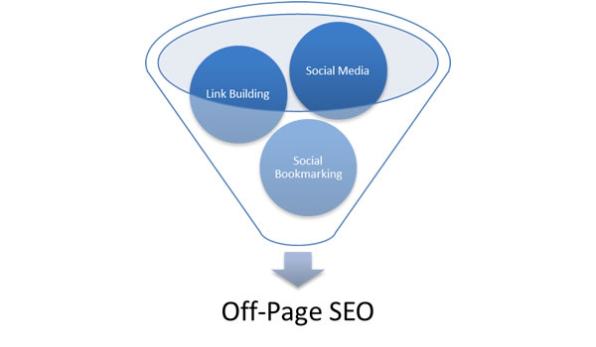
Off –Page Optimization–Website Backlinks
Offpage optimization refers to all the measures that can be taken outside of the actual website in order to improve its position in search rankings.

Slide 63
Off –Page Optimization–Website Backlinks
Link Building
Basically by building external links to your website, you are trying to gather as many ‘votes’ as you can, so that you can bypass your competitors and rank higher.
The most popular ways were:
Blog Directories – something like yellow pages but each entry had a link pointing to a website.
Forum Signatures – Many people were commenting on forums for the sole purpose of getting a link back to their website

Slide 64
Off –Page Optimization–Website Backlinks
The most popular ways were:
Blog Directories – something like yellow pages but each entry had a link pointing to a website.
Forum Signatures – Many people were commenting on forums for the sole purpose of getting a link back to their website
Comment link – The same concept as forum signatures where you would comment on some other website or blog in order to get a link back.
Article Directories – By publishing your articles in article directories you could get a link back to your website.

Slide 65
Off –Page Optimization–Website Backlinks
The most popular ways were:
Shared Content Directories – Websites like hubpages and infobarrel allowed you to publish content and in return you could add a couple of links pointing to your websites.
Link exchange schemes – Instead of trying to publish content you could get in touch with other webmasters and exchange links.

Slide 66
Off –Page Optimization–Website Backlinks
Social Media
Social media is part of ‘off-site SEO’ and if you think about it, it’s also a form of link building.
It should be noted that almost all of the links you get from social media sites are “nofollow” but this does not mean that they do not have any value.

Slide 67
Off –Page Optimization–Website Backlinks
Social Media
Social media is part of ‘off-site SEO’ and if you think about it, it’s also a form of link building.
It should be noted that almost all of the links you get from social media sites are “nofollow” but this does not mean that they do not have any value.

Slide 68
Off –Page Optimization–Website Backlinks
Social Bookmarking
Social bookmarking is not as popular as it used to be in the past but it is still a good way to get traffic to your website.

